Slide 1
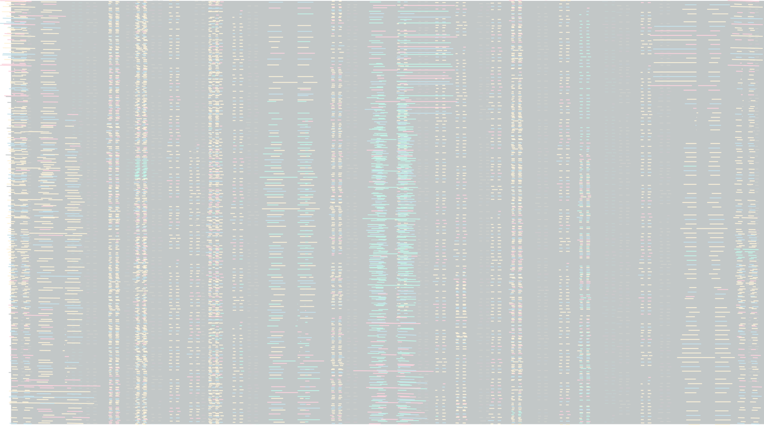






LOGO COMPANY
Crime Track Analysis!
Presented by :- Anushka Bhawalkar & Jyoti Bhati

Slide 2




LOGO COMPANY
01.
INTRODUCTION
The “Crime Track Analysis” is a project where we analyzed the crimes and their patterns over the course of years. We have used two excel sheets to perform our analysis as deep as we could. Now let’s take a look at the valuable insights that we got out of this analysis.

Slide 3





LOGO COMPANY
OUR INSIGHTS
What did we use for database?
We used SQL, mysql, mysqlalchemy for database.
What tools did we use for analysis?
We have done this analysis using, Python libraries like, numpy, pandas, and matplotlib and, SQL..

Slide 4

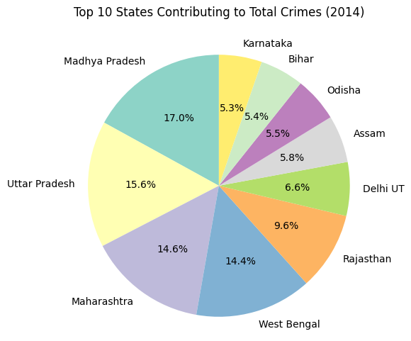

LOGO COMPANY
Let’s see the Crime % per State!

Slide 5

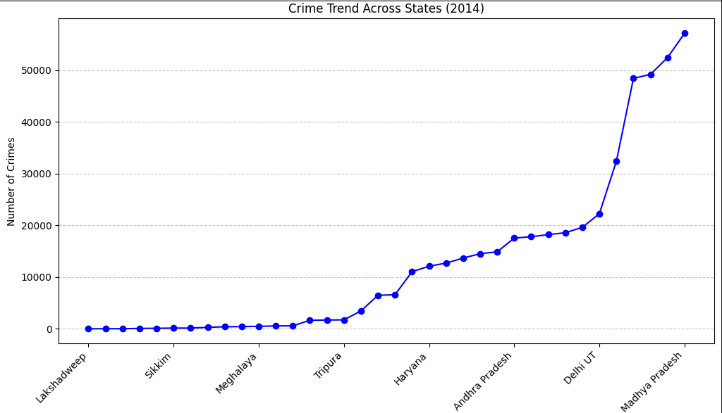


LOGO COMPANY
Crime Trend Across States

Slide 6

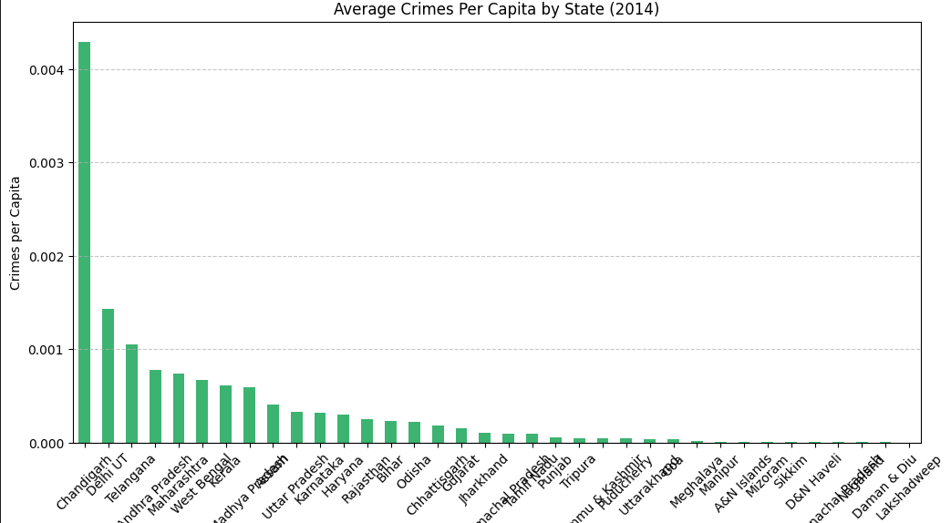


LOGO COMPANY
Average Crimes per capita by State!

Slide 7

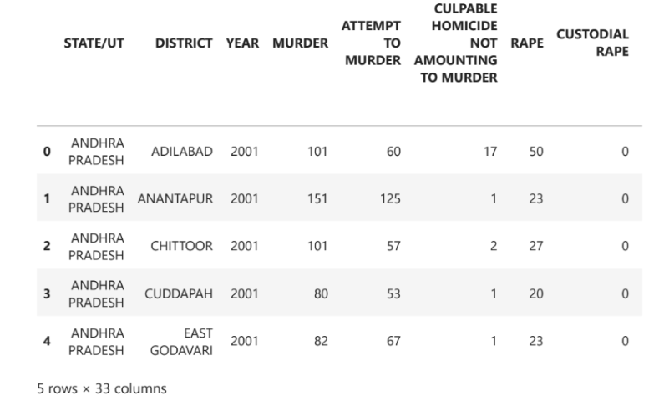

LOGO COMPANY
SQL DATA INSERTION SUCCESSFUL

Slide 8
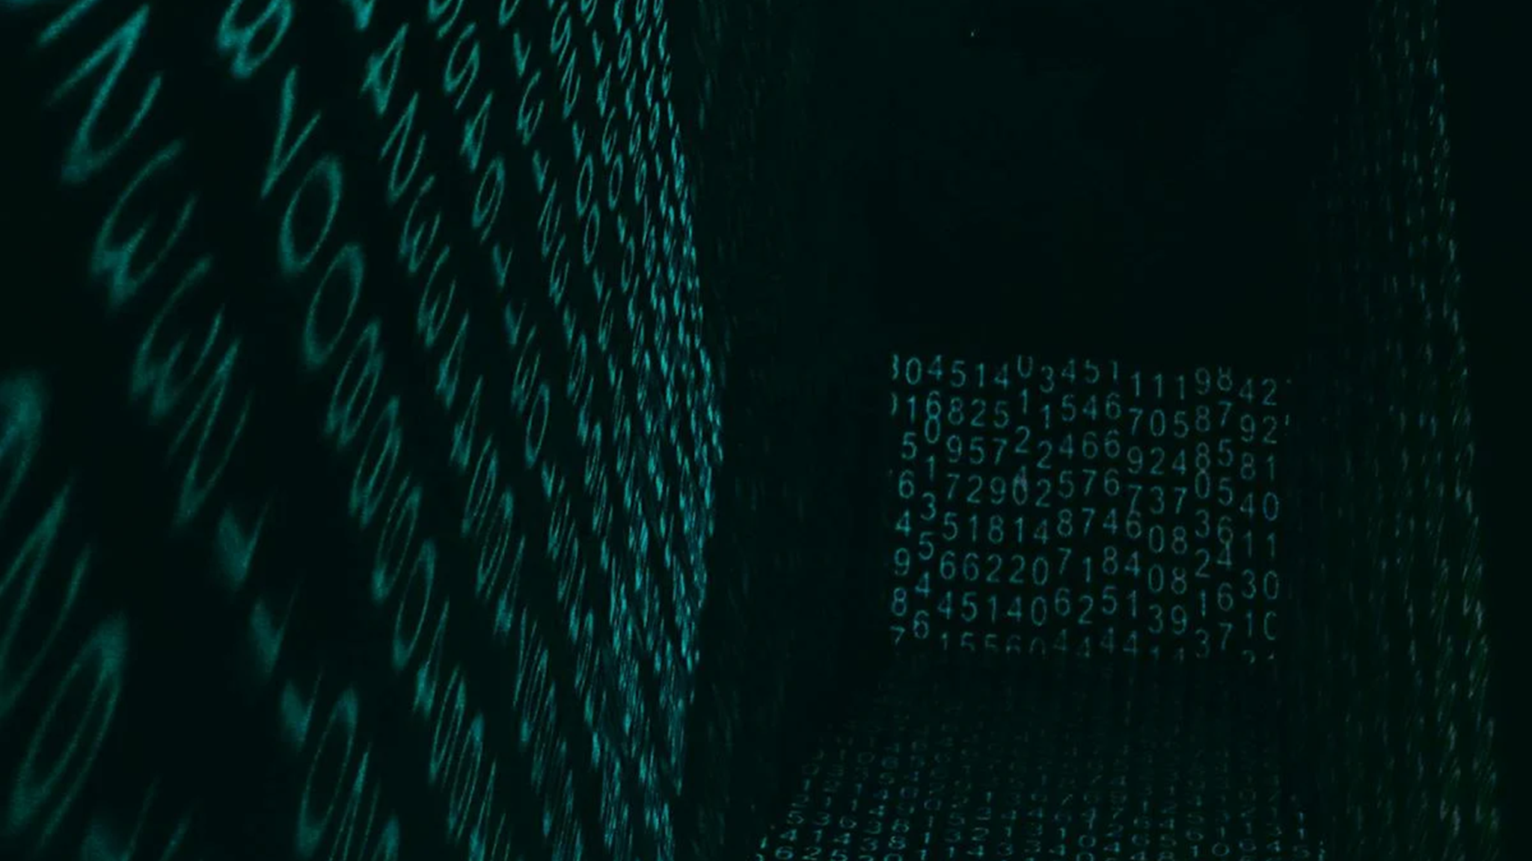

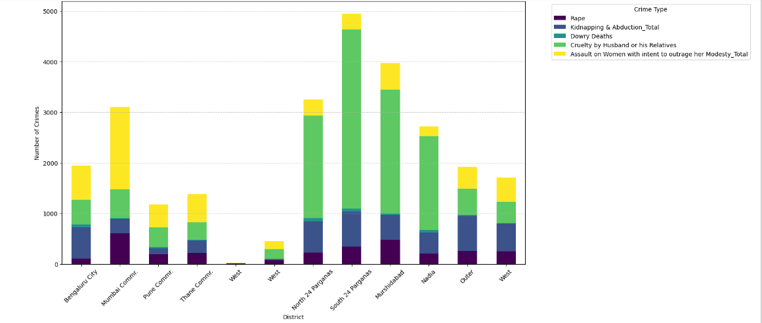
Crime Type Comparison!!
LOGO COMPANY

Slide 9

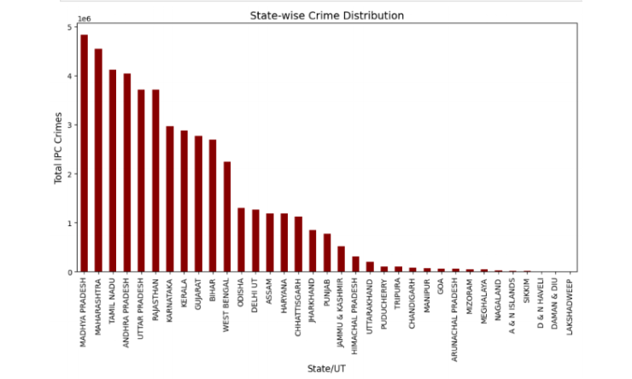

State Wise crime distribution
WRITE AN ORIGINAL STATEMENT OR INSPIRING QUOTE
— Include a credit, citation, or supporting message

Slide 10
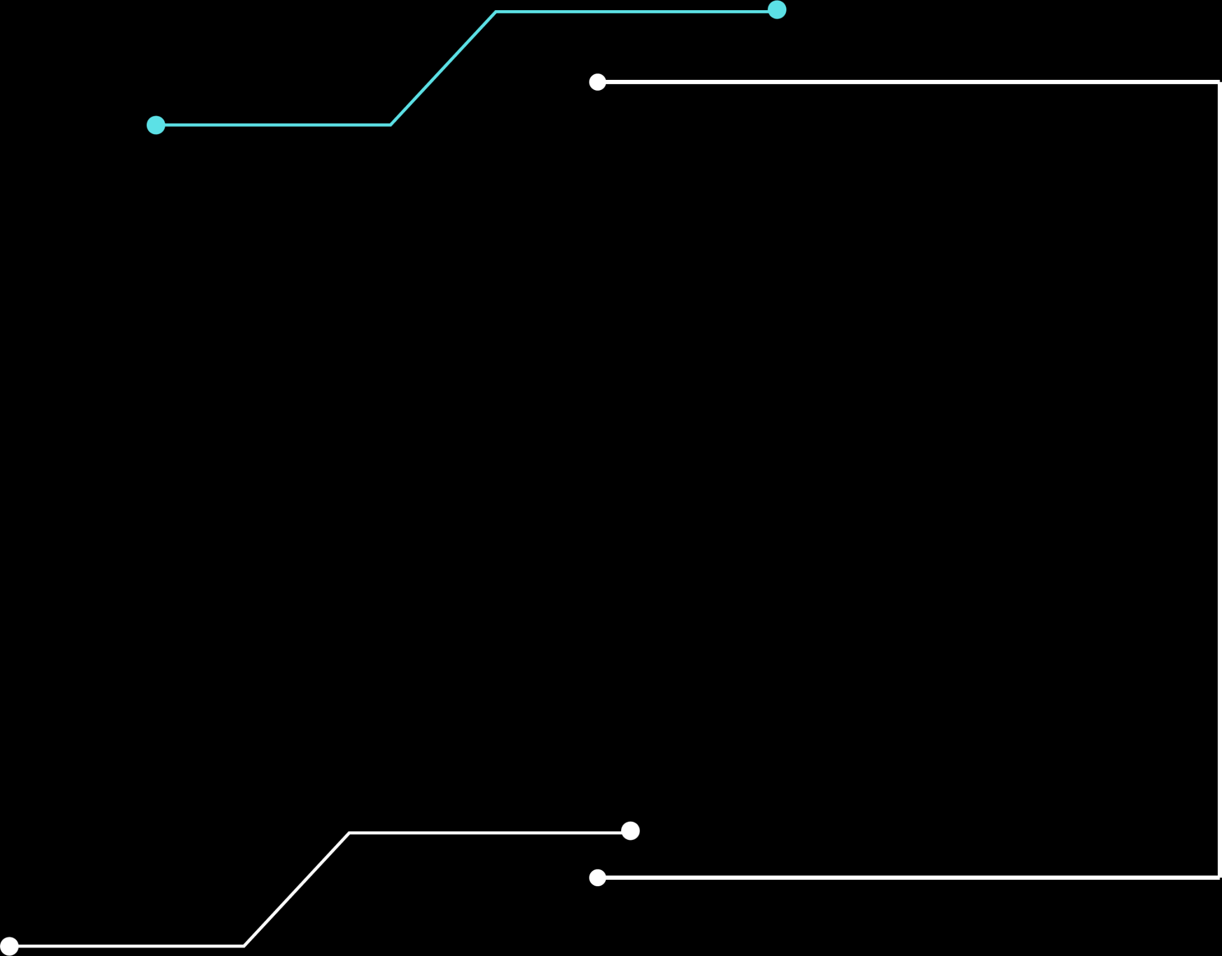
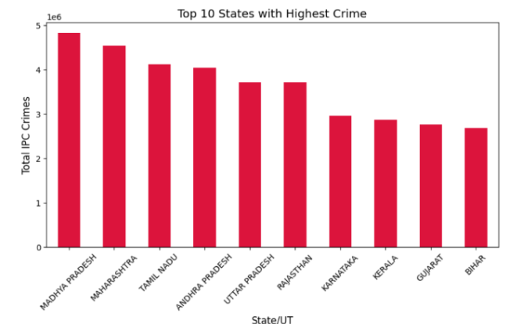


LOGO COMPANY
Top 10 states with highest crimes
123 Anywhere St., Any City,ST 12345
123-456-7890
hello@reallygreatsite.com
@reallygreatsite
reallygreatsite.com

